Slide 1





Musical micro:bit
Teacher lesson guide
Lesson 4

Slide 2
Learning objectives:
To identify how inputs are used in programs.
To write programs that use inputs and selection.
To write and evaluate algorithms.

Slide 3
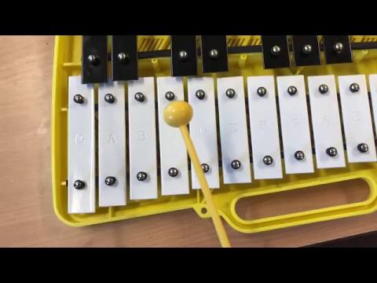
3, 2, 1, program
Use the MakeCode editor to write a program using as few blocks as possible to create the same musical phrase that is in the video.
https://youtu.be/oPcdq0VAAh4
Notes:
See slide 10 program 1 for an example of a suitable answer.

Slide 4
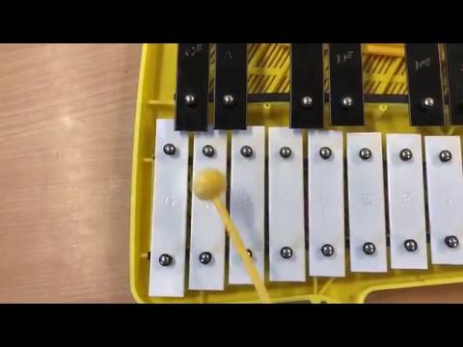
3, 2, 1, program
Use the MakeCode editor to write a program using as few blocks as possible to create the same musical phrase that is in the video.
https://youtu.be/jPd3De6wnbo
Notes:
See slide 10 program 2 for an example of a suitable answer.

Slide 5
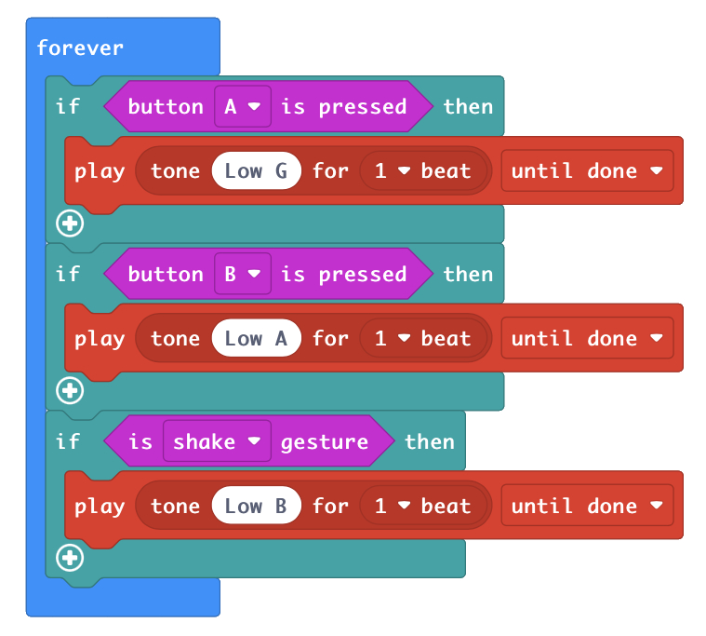
Selecting conditions
What do you know about this program?
Think about the concepts used, the blocks used and the output.
Write down statements about this program on your large sheet of paper.
Notes:
Possible statements:
The program contains a forever loop.
The program uses 7 blocks.
The programs has blocks from 3 different menus (basic, logic and music).
The program uses repetition and selection.
The program uses 3 inputs (button a, button b and shake).
When button a is pressed note low g will be played.
When button b is pressed note low a will be played.
When the micro:bit is shaken note low b will be played.
Instrument hex file: https://makecode.microbit.org/_dbVfib2M0Lmo

Slide 6
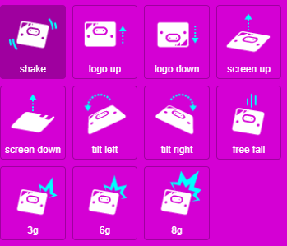
Selecting conditions
Complete the program by using additional inputs that make use of the micro:bit’s accelerometer.
Notes:
Instrument hex file: https://makecode.microbit.org/_dbVfib2M0Lmo

Slide 7
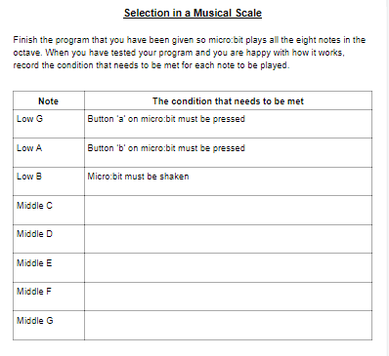
Selecting conditions
Once you have selected a condition, add this and the note that will be played onto the selection in a musical scale sheet.

Slide 8
Writing algorithms
Write an algorithm to show someone how to use a micro:bit to play one of the musical phrases you composed in lesson 1.
Once you have tested and debugged your algorithm, swap with another pair and evaluate their algorithm.
Are the instructions clear and easy to follow?
Is any of the language confusing?
Can any of the language be misinterpreted?
Can fewer instructions be used in the algorithm?

Slide 9
Learning objectives revisited:
To identify how inputs are used in programs.
To write programs that use inputs and selection.
To write and evaluate algorithms.

Slide 10
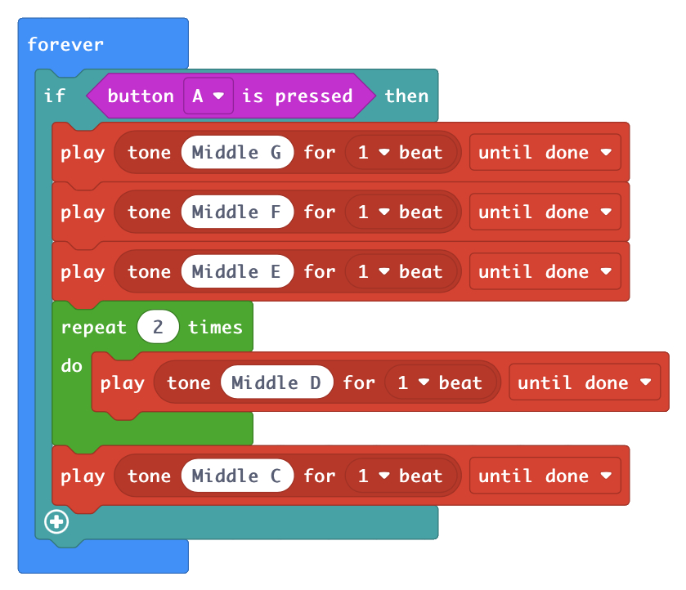
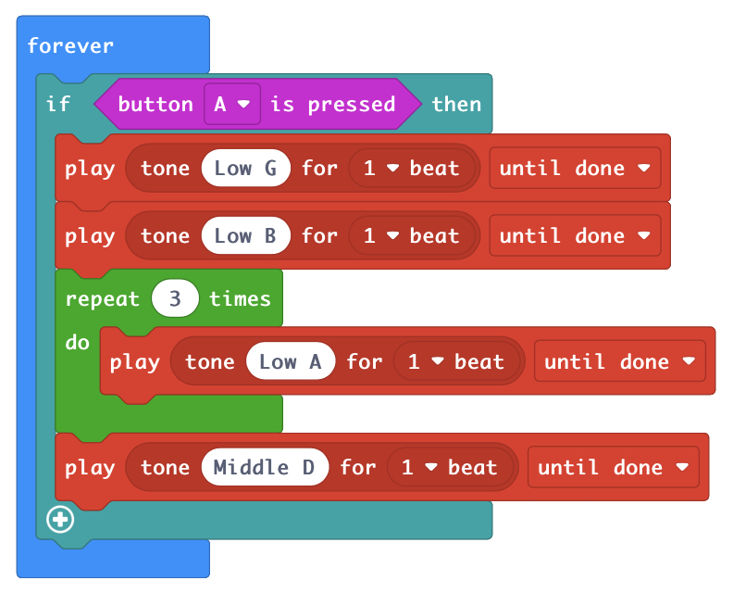
1, 2, 3 program examples
program 1
program 2

